Slide 1


Exploration of SARS-CoV2
Data Analytics Bootcamp Capstone Project
Notes:
Background Image Citation:
SARS-CoV2 Virus. Adapted from “Transmission of SARS-CoV-2: implications for infection prevention precautions,” by World Health Organization , 2020, July 9, (https://www.who.int/news-room/commentaries/detail/transmission-of-sars-cov-2-implications-for-infection-prevention-precautions). In the public domain

Slide 2




STUDENT TEAM
Bill Remy
Phoenix, AZ
Celeste Moreno-Campoy
Phoenix, AZ
Samuel Guerette
Phoenix, AZ
Joy Arah
Phoenix, AZ

Slide 3
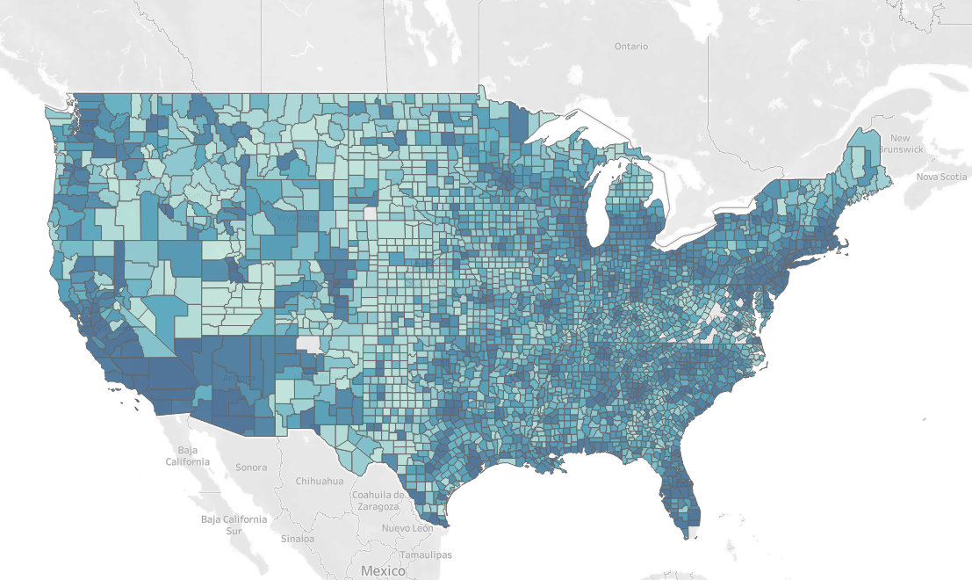
Investigation of COVID-19 Goal
Figure 2. Tableau US Counties
Our Mission
Using Covid-19 as a reference, develop a model to prepare for future pandemic outbreaks by directing resources to poor-performing counties based on medical, political, and socio- economic factors.
Questions
Which counties are high risk?
Which features have the greatest impact?
Notes:
-Reason Why: COVID has drastically affected the world, threatening the lives of millions and wreaking havoc on social and economic players. Although COVID-19 has slowly become understood and there have been implementations for disease control, the threat of infectious diseases is still alarming. Throughout the primary years of COVID-19, it became evident that particular locations of the US were heavily affected while others were not. Thus, it is imperative to understand predicting factors and their relationships that may affect both case and death rates. By indicating high-priority areas in the US, one can reallocate resources to those locations and provide further assistance to combat spread. Additionally, this information can be transposed to future implications if another pandemic were to occur in the near future.

Slide 4
Data Sources
SARS - C0V2 - Case/Mortality Data by state/county
Socio-economic data
Health & Health Provider data
Political data

Slide 5
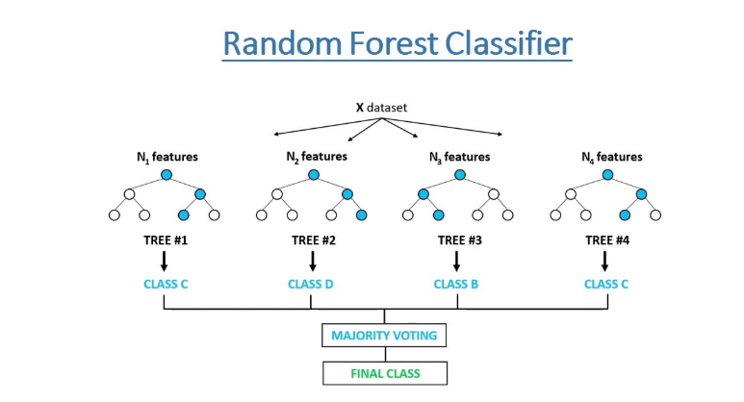
Chosen Language & Technology
Coding Language: Python
Visualization: Tableau and Jupyter Notebook (Pandas)
Database: AWS, Postgres
Machine Learning Model: Random Forest Classification
Why Random Forest?
Provides higher level of accuracy compared to decision tree algorithm
No need for scaling
Easy to measure the relative importance of each feature
Can handle both categorical and numerical data
Drawbacks of Random Forest
Can take a long time to train
Not easily interpretable
Poor performance on imbalance data
Figure 3. Random Forest Classifier. Adapted from “Random Forest Classifier Tutorial?” by freeCodeCamp, 2022, (https://www.freecodecamp.org/news/how-to-use-the-tree-based-algorithm-for-machine-learning/). In the public domain

Slide 6

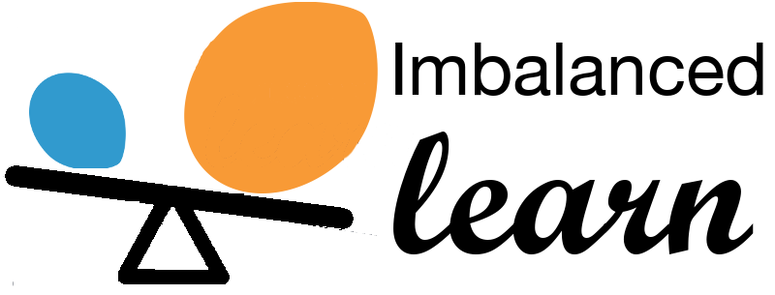







Tools Used Throughout the Project
Notes:
IMBLearn
Smoteenn Combination of over and under sampling method that is valuable for imbalance data
Psycopg2
Used to perform operations on PostgreSQL using python, it is designed for multi-threaded applications
Tableau
Public data visualization tool that provides pictorial and graphical representation of data
Jupyter Notebook
Web-based platform for interactive computing
Pandas
High level building block for analysis
Scikit-Learn
Robust machine learning library including classification, regression, cluster, etc.
Sqlalchemy
Library that facilitates the connection and communication between the database and jupyter notebook
AWS
Database hosting
Python
Main programming language for data cleansing, manipulation, and modeling

Slide 7
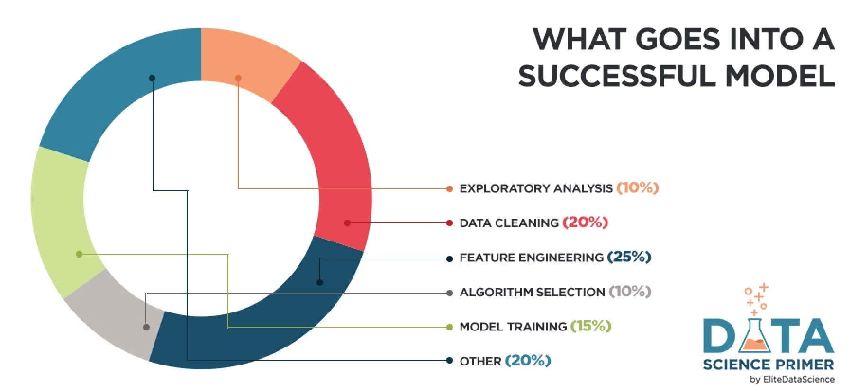
Phases of COVID-19 Model
Data Exploration
Data Preprocessing (AWS & Pandas)
Uncover initial patterns & characteristics
Begin to uncover data feature importances
Create visualizations
Data Analysis
Final pre-processing (Pandas)
Model planning
Solidify feature importances
Explore multiple models
Modeling Building
Establish best ML model
Optimize Model
Communicate Results
Create final visualizations
Figure 3. Machine Learning Process. Adapted by “Feature Engineering for Machine Learning” by Elite Data Science, 2022, July 14,( https://elitedatascience.com/feature-engineering). In the public domain
Notes:
Celeste: As a group, it was critical to implement an overall project outline to ensure all deliverables of the culminating challenge were met. This included recognizing all the essential components of a successful machine learning model, such as exploratory analysis, data cleaning, feature engineering and so forth. It is critical to note that data cleaning and feature engineering are some of the highest contributors to a successful model, holding almost half its importance. As a result, the team noted this and ensured these components were adequately met. The first stage was geared toward data exploration, while the second focused on data analysis and modelling building. During both phases, data pre-preprocessing took place, although most of the heavy work took effect during our database development. Additionally, visual analytics were utilized during both parts to view overall data characteristics and patterns.

Slide 8
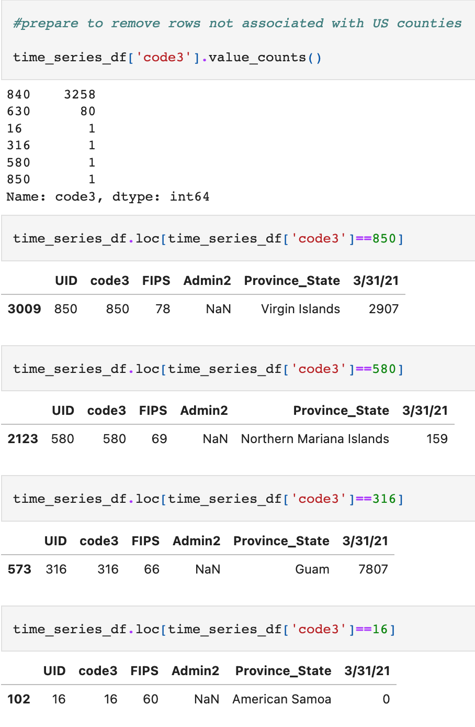
Data Exploration & Preparation
View overall shape of datasets (Pandas)
Data features
Statistical analysis
Proper county data: Federal Information Processing Standards (FIPS) column
Relevancy towards project
Utilized Tableau and Jupyter Notebook to create visual analytics and search for valuable insights of data.
Drop inadequate datasets
Pre-processing and merging (Postgres)
Two master tables: cases & deaths
Figure 4. FIPS Data Exploration
Notes:
Celeste: Previous to building the database, it was necessary to employ a brief data exploration assessment in Pandas. Exploration allows for a deeper understanding of the dataset, making it significantly easier to navigate and utilize during database development and data analysis. This included determining overall column features and their application to the project scope, discovering mismatched or null data values, and statistical analysis. Transformation and concatenation of data was employed to ensure feature value FIPS, a unique numerical code for each county, was present in all datasets for future merging. Additional cleaning of the FIPS column was needed to certify that it only included US county data and not those outside the country, such as Puerto Rico, or any cities. Additionally, in both Tableau and Jupyter notebook, visuals were created to have a different view of the data feature characteristics at the county level. These evaluations aided in determining if the dataset was sufficient to be used further in the project. If the dataset or certain features were found to be insufficient, it was necessary to drop them from further research. After utilizing pandas and tableau for data exploration, further preprocessing took place in Postgres to merge and prepare data for analysis. The result was two master tables, one geared toward COVID-19 deaths and the other cases.

Slide 9
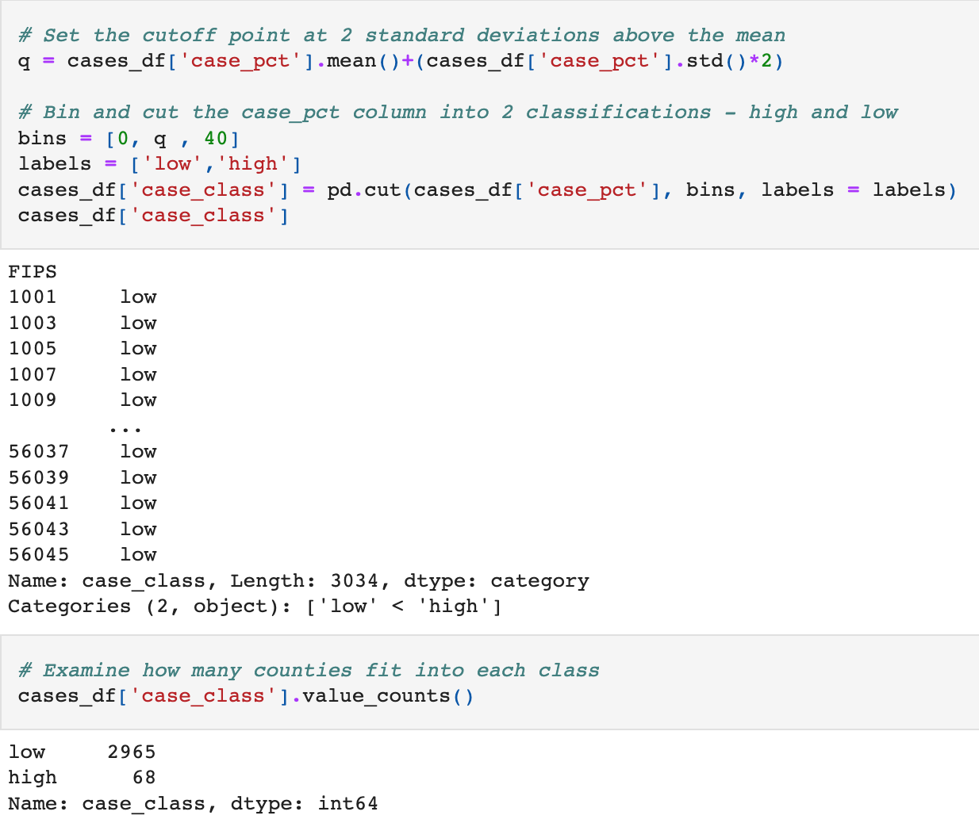
Model Plan
Regression vs Classification?
Model Goal: Classify counties by case & death percentage, with a “high” classification = mean + 2 std. deviations
Training:Testing = 70:30
Settled on Tree Classifier models
Best Performance: Random Forest
Figure 5. Pandas COVID-19 High Risk Classification
Notes:
Regression vs Classification?
unable to get regression accuracy to our desired levels - tried linear, Forest regressors, Neural Networks, Poisson
Tree classifiers performed better than neural networks, especially once data was resampled with SMOTEENN
Model Goal: Classify counties by case & death percentage, with a “high” classification = mean + 2 std. deviations
Training:Testing = 70:30
Settled on Tree Classifier models
Best Performance: Random Forest

Slide 10
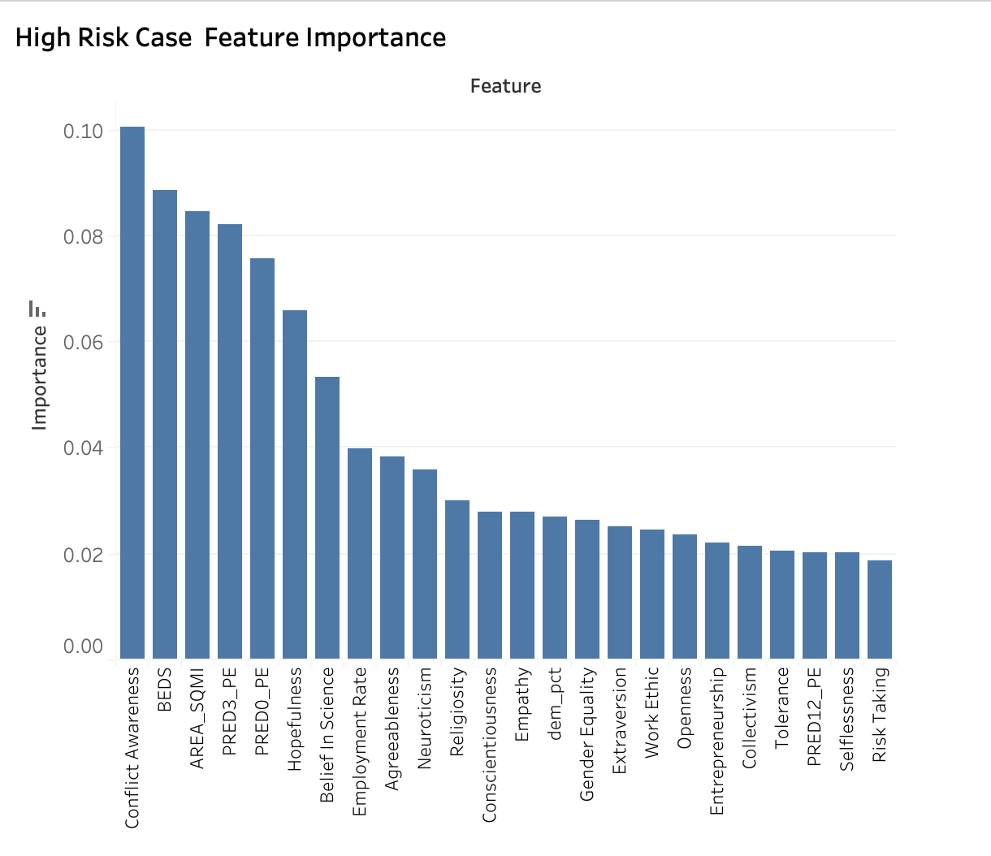
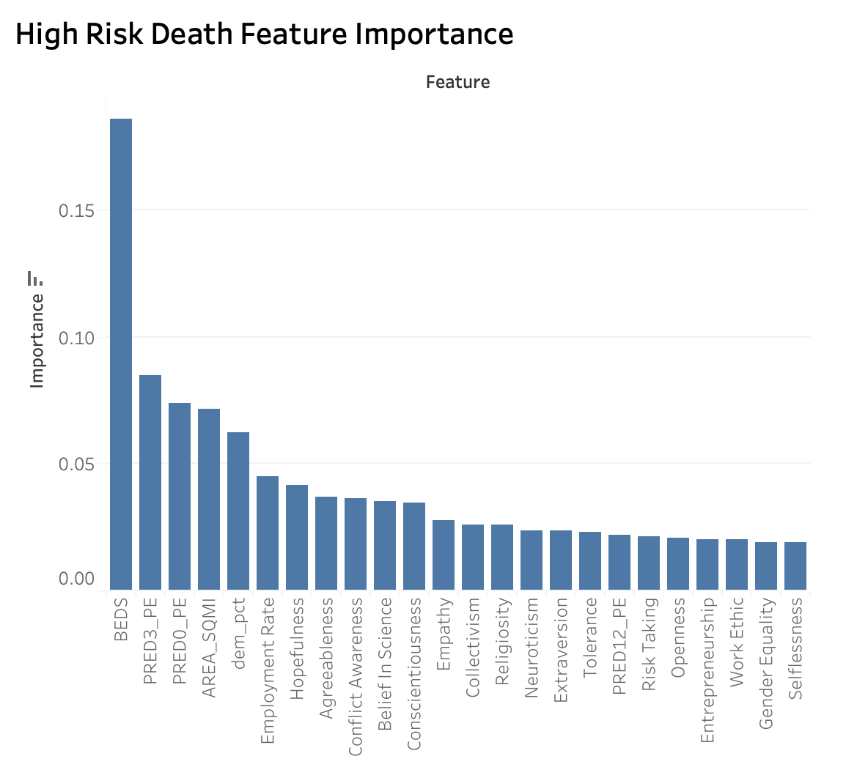
Decision Tree SMOTEENN Model Feature Engineering & Analysis
Total of 24 Features
Figure 6. Tableau COVID-19 SMOTEENN Case Feature Importance
Figure 7. Tableau COVID-19 SMOTEENN Death Feature Importance
Notes:
Settled on 24 features - 1 political, 1 hospital, 1 geographical, 3 community resilience, 18 social context
Top three features:
Cases:
Conflict awareness
Hospital beds
Area per Square Mile (SQMI)
Six total features were found to have significant influence
Deaths:
Hospital beds
Rate of individuals with three plus risk factors
Rate of individuals with zero risk factors
Hospital beds is the primary feature, all others are significantly less important

Slide 11
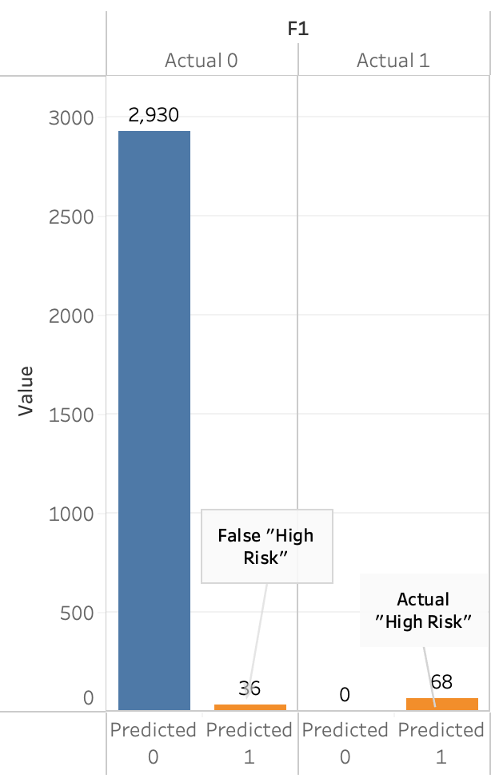
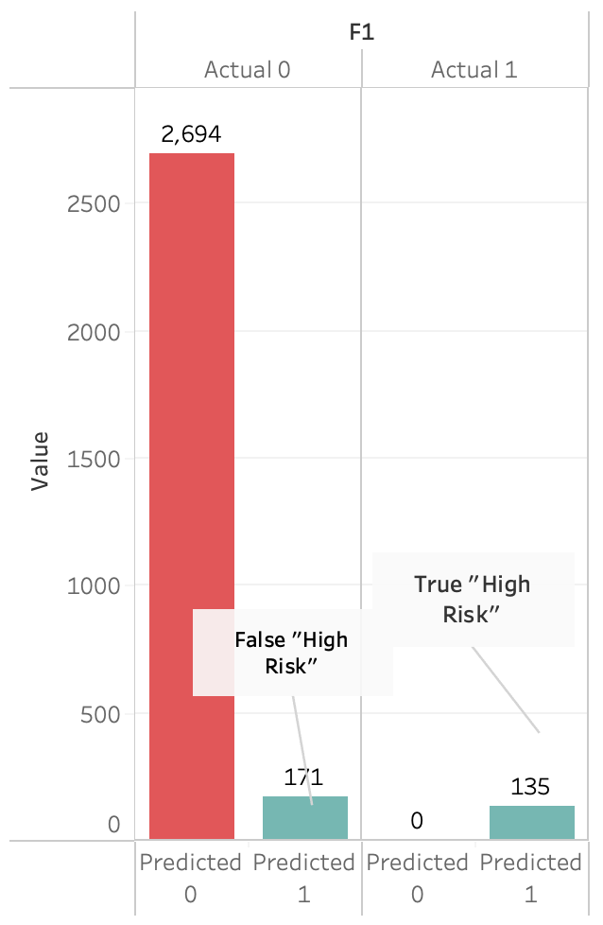
Results of Random Forest Classification
COVID-19 Cases
COVID-19 Deaths
Figure 8. Tableau SMOTEENN RF COVID-19 Case Confusion Matrix
Figure 9. Tableau SMOTEENN RF COVID-19 Death Confusion Matrix
Notes:
RFC Code: https://github.com/sdguerrette/capstone_project
3034 rows for cases
3000 rows for deaths

Slide 12
Classification Results
 | Classification | Precision | Recall | Specificity | F1
Cases | Low | 1.00 | 0.99 | 1.00 | 0.99
 | High | 0.65 | 1.00 | 0.79 | 0.99
Deaths | Low | 1.00 | 0.94 | 0.97 | 0.93
 | High | 0.44 | 1.00 | 0.94 | 0.61
Notes:
Decision Tree Classifier with SMOTEENN resampling expressed higher results compared to past models
Proceeded to move forward with Random Forest Classifier
Possibility of greater performance
Recall was the stat we focused on the most - catching all of the high class was most important. Classifying some actual low class as high is not as big a deal

Slide 13
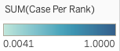
Percentile Ranking of Cases by County : March 2020 - March 2021
Figure 10. Tableau COVID-19 Case Ranking

Slide 14
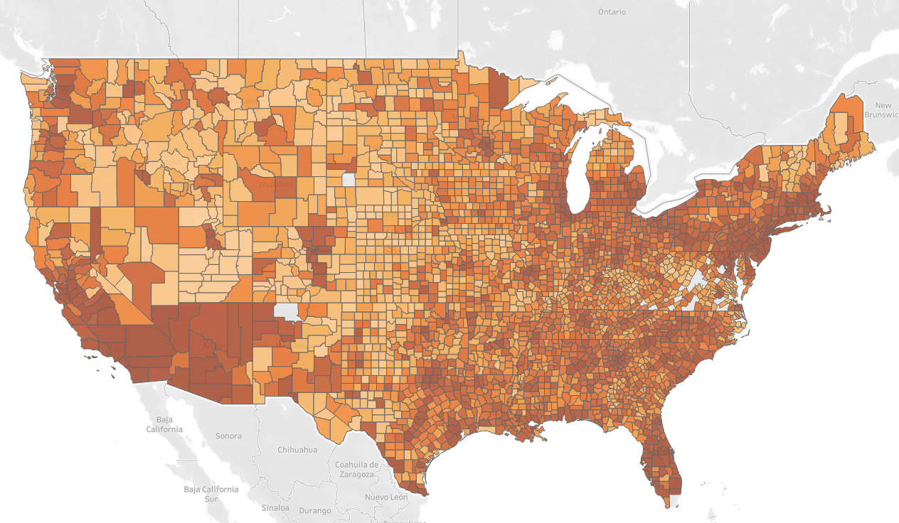
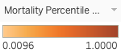
Percentile Ranking of Deaths by County : March 2020 - March 2021
Figure 11. Tableau COVID-19 Death Ranking

Slide 15
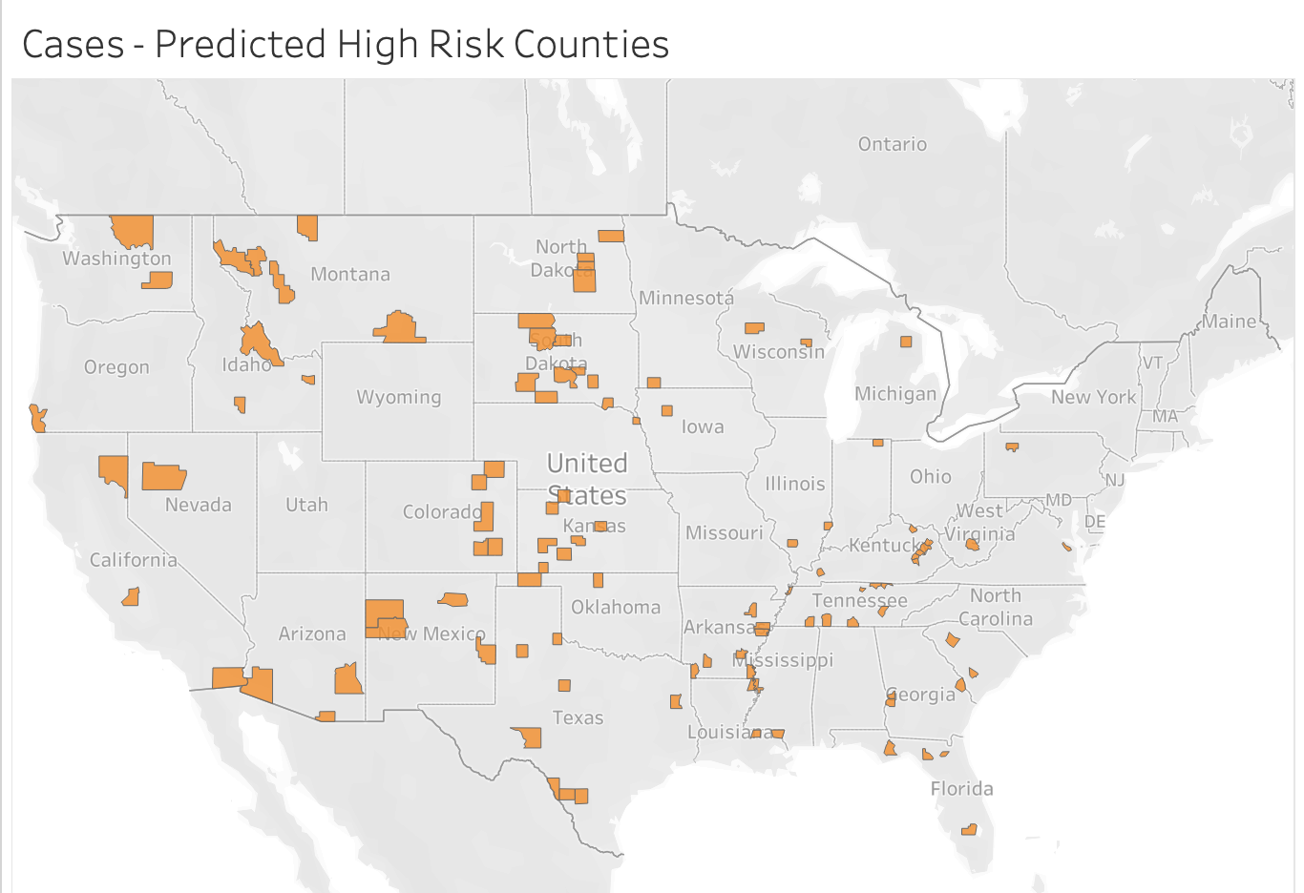
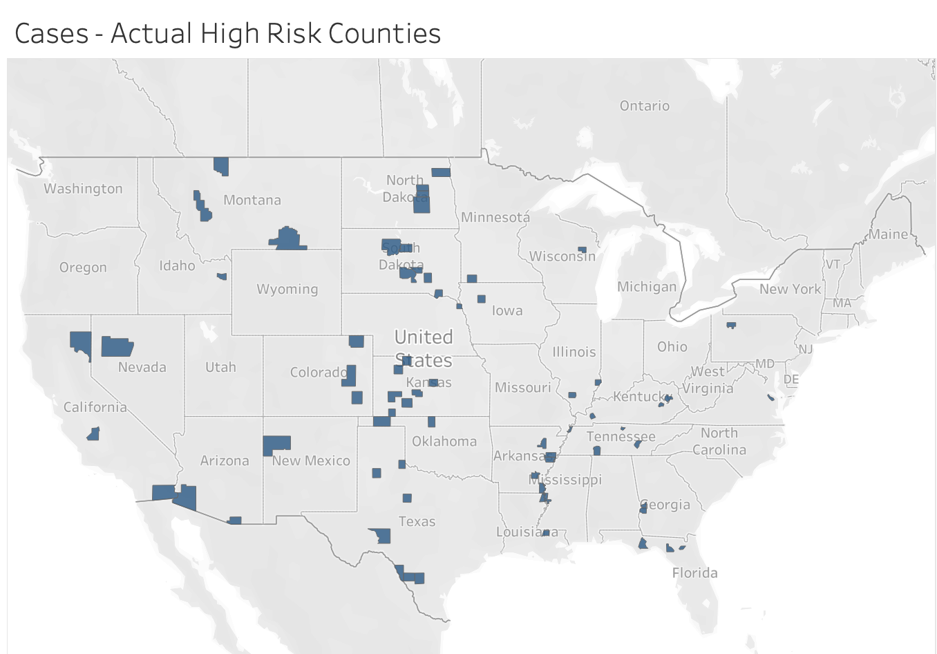
Cases by County : Actual vs. Predicted
Figure 12. Tableau RF COVID-19 Predicted High Case Results
Figure 13. Tableau RF COVID-19 Actual High Case Results
Accurately predicted “Low Risk” 2,930 Counties / “High Risk” 68 Counties
Falsely Predicted “High Risk” 36 Counties

Slide 16
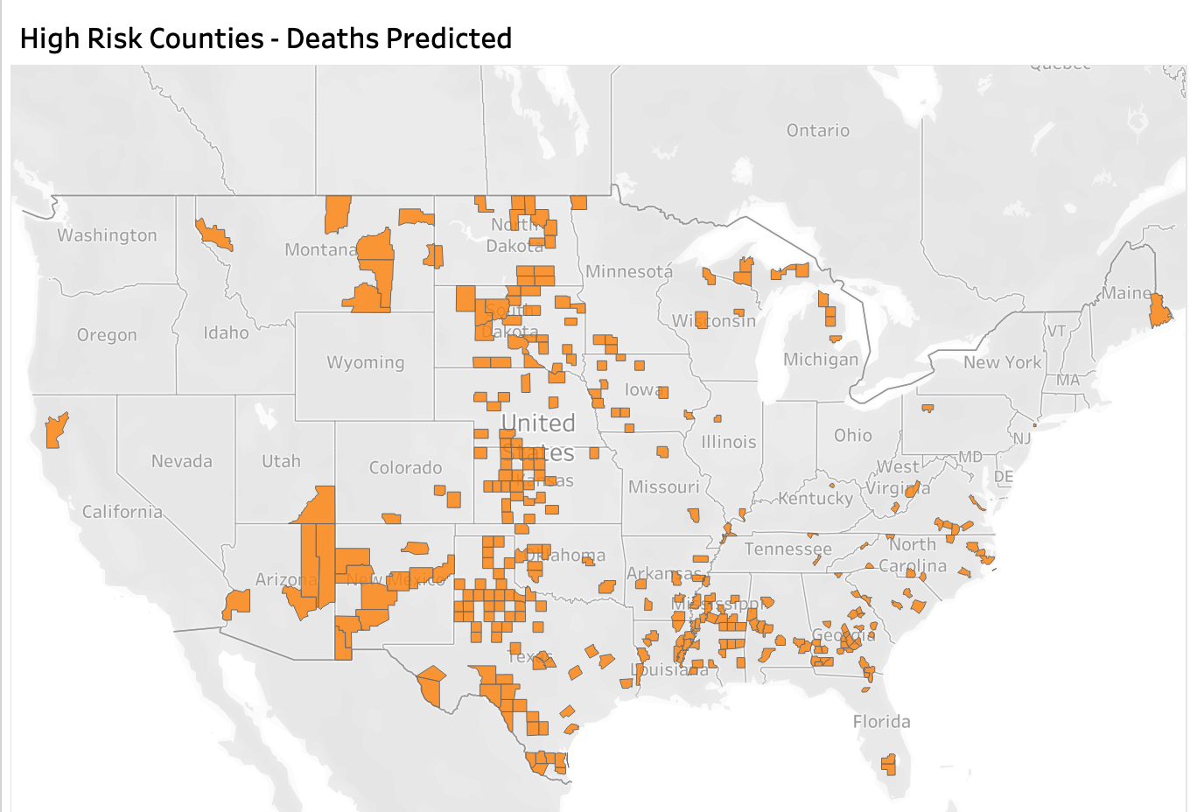
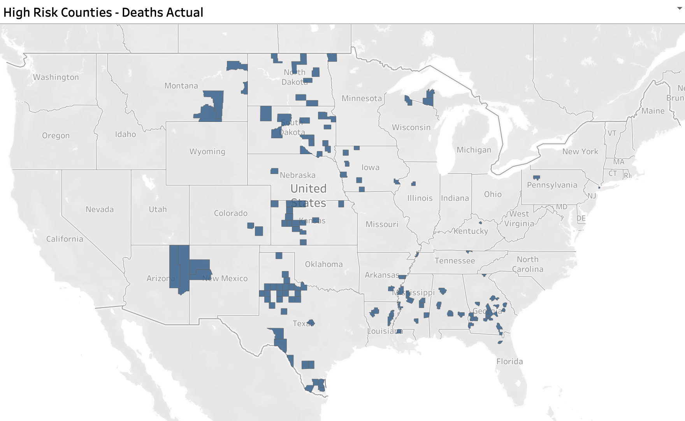
Deaths by County : Actual vs. Predicted
Figure 14. Tableau RF COVID-19 Predicted High Death Results
Figure 15. Tableau RF COVID-19 Actual High Death Results
Accurately predicted “Low Risk” 2,964 Counties / “High Risk” 135 Counties
Falsely Predicted “High Risk” 171 Counties

Slide 17
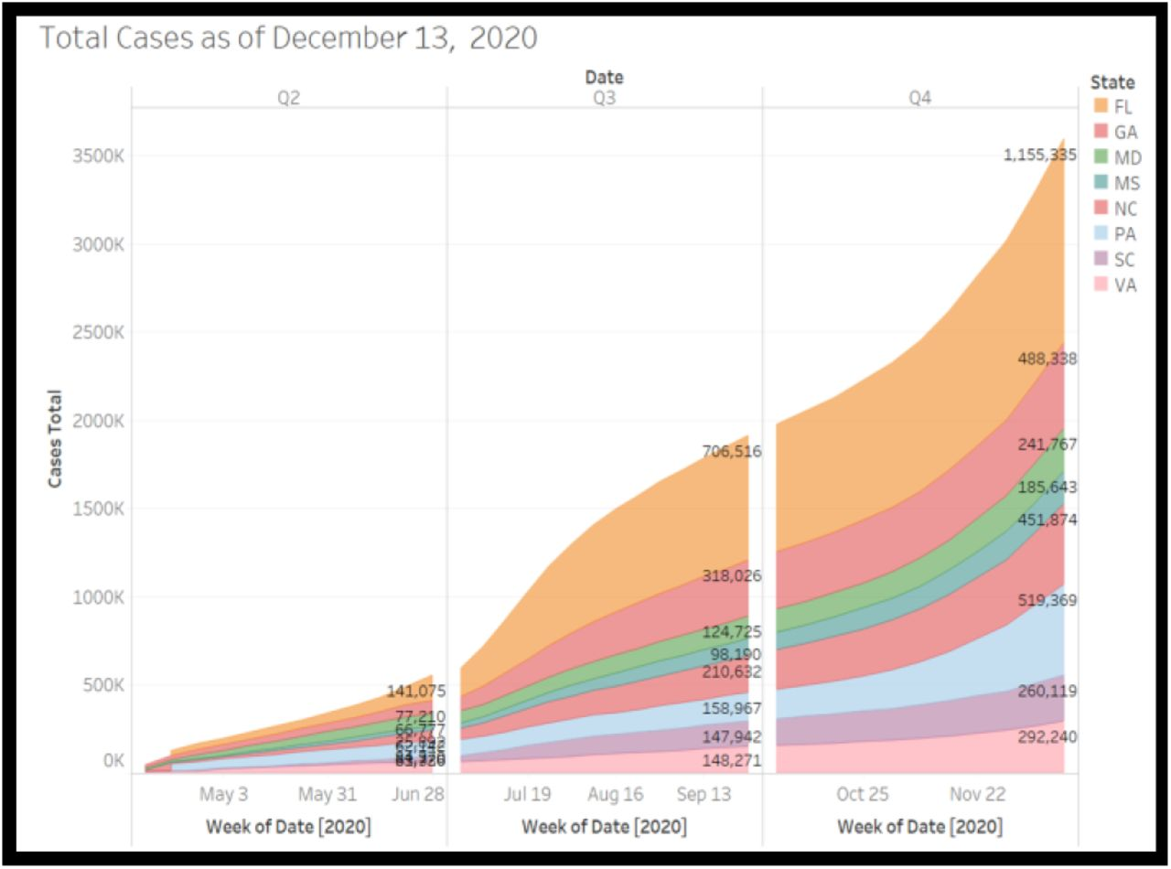
Recommendations for Future Analysis
Integrate a time series analysis to view quarterly, monthly, and daily differences at the county and state level.
Add weather data in conjunction with time series
Include vaccination data at state and county level
Proceed with further predictions of high case & death rates at county level for 2022
Figure 16. Area graph of Total COVID 19 cases. Adapted from “A Time Series Analysis and Predictive Modeling of COVID-19 Impacts in the African American Community” by Oladunni et al., 2021, (https://doi.org/10.1101/2021.05.13.21257189).In the public domain
Notes:
Celeste: Concerning future analysis, it would be beneficial to integrate a time series analysis to view quarterly, monthly, and daily differences. This can provide further insight if any features have significant changes in their importance depending on the time frame. Additionally, adding weather data in conjuction with the time series will be beneficial in evaluating weather's contribution to high case and death rates. Some experts have expressed that the COVID virus exhibits lower activity in hotter climates in the summer while climbing during winter. It would be fascinating to test this theory. Another possible avenue would be the inclusion of vaccination data. This can shed light if the county's complete, partial, or lack of vaccination significantly affects high death and case rates. Proceeding even further, it may be possible to view if a particular vaccine (Moderna, Pfizer, or J&J) was more prevalent in a specific county and if one was more effective than its counterparts based on death and case rates. Lastly, it would be interesting to implement the model for case and death rates during March 2021-2022 to view its performance.

Slide 18
Looking Back
Implement a Gantt Chart to delegate responsibilities and roles per week
Include major deliverables along with necessary sub-tasks to complete weekly deliverables
Beneficial in seeing progress and high priority project segments
Reduces confusion of role responsibilities
Start with the simplest ML model and increase complexity each week
Evaluation of quality and impact of datasets taking place earlier in the project
One dataset, although at first glance may seem like a good fit, can negatively impact the performance of an ML model.
Notes:
Celeste: Although the team is proud of what we have accomplished during our allotted project time frame, there are some areas that we would've executed differently. The first pertains to the primary steps of our project and establishing organization. It may have been beneficial to create a brief Gannt chart to delegate responsibilities, including major deliverables and their necessary subtasks. This chart will be helpful in seeing progress and viewing tasks ahead, behind, or on schedule. If a particular subtask is behind schedule, group members can quickly provide assistance.
In terms of the machine learning model, it is best to start simple and then increase complexity each week. Initially, the group started with a neural network model, which then led to backtracking. Lastly, it would've been helpful to implement a thorough quality assessment of the data and their specific impact on the ML model earlier in the project. About 3/4 of the way into the project, it was discovered that one of our datasets was the contributor to Machine learning errors. This was discovered after implementing various ML models. Although a difficult lesson to learn, it is vital to know that a dataset can initially look promising but negatively impact performance. If the error had been found earlier due to a quality assessment, this would've negated unnecessary confusion and frustration during the machine learning building process.

Slide 19
Thank You for Listening!
Any Questions?

Slide 20
Chosen Source Data
US census 2021: https://www2.census.gov/programs-surveys/popest/datasets/2020-2021/counties/totals/
Displays overall population estimates, deaths, births, domestic migration, etc., by county.
Social Context for Understanding a Region: https://www.statsamerica.org/downloads/default.aspx
Gives social context data, such as as measurements of hopefulness, employment rate, conscientiousness, etc. by county data.
Social Vulnerability Index (SVI): https://www.atsdr.cdc.gov/placeandhealth/svi/
Provides estimates of poverty, unemployment, those above 65, disability, etc. by county.
Case Time Series Data - Johns Hopkins University: https://github.com/govex/COVID-19
Displays cumulative cases from 01/01/2020 - 10/03/2021 by US county.
Death Time Series Data - Johns Hopkins University: https://github.com/govex/COVID-19
Displays cumulative deaths from 01/01/2020 - 10/03/2021 by US county.
County Presidential Election Returns 2000-2020: https://electionlab.mit.edu/data-
Provides party affiliation from election returns at a county level.
Community Resilience Estimates: https://uscensus.maps.arcgis.com/home/item.html?id=36d5cbbcd9fd440e91d87edd8bc9c801#overview
Provides data to measure the capacity of individuals and households to absorb the external stresses of the impacts of a disaster
County Hospital Data: https://hifld-geoplatform.opendata.arcgis.com/datasets/geoplatform::hospitals/about
Gives insight to total number of beds available in hospitals within the county level.

